Slide 1

Stockify
Model for Estimating Stock Performance (checkpoint 4)
By: Abdullah salau

Slide 2
Checkpoint Goals
Additional Models
Ridge Regression
Lasso Regression,
Random Forests
Regression Report

Slide 3
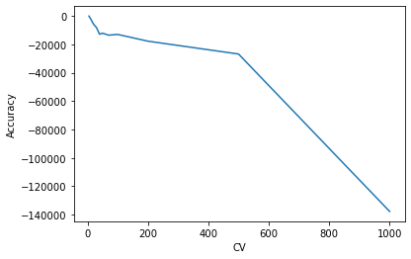
Ridge Regression
•Initial Cross Validation results with Normalization to regularize dataset
Notes:
BEFORE IMPUTATION OF MISSING VALUE

Slide 4
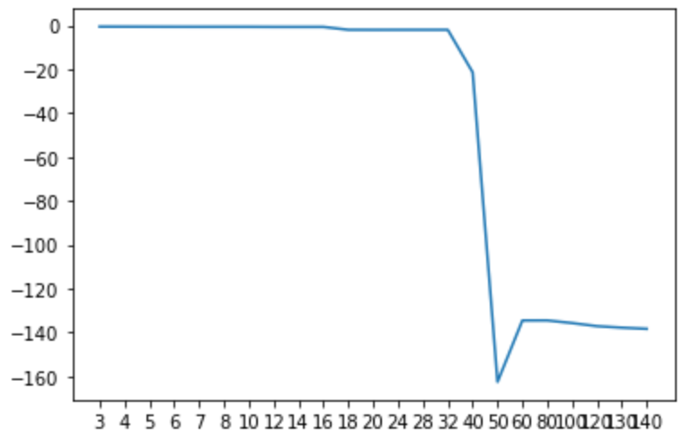
Ridge Regression
•Using selectKBest, with removing attributes with low correlation with target variable but reducing threshold to increase features (|x|<0.001 gave us 143 features instead of 15), 5CV folds, and normalize2 (r2 scoring)
Notes:
BEFORE IMPUTATION OF MISSING VALUE

Slide 5
Ridge Regression
•Using Grid Search for hyper parameter tuning gives us the following setting for our Ridge model: Best Hyperparameters: {'alpha': 100, 'fit_intercept': False, 'normalize': True}
Notes:
BEFORE IMPUTATION OF MISSING VALUE

Slide 6
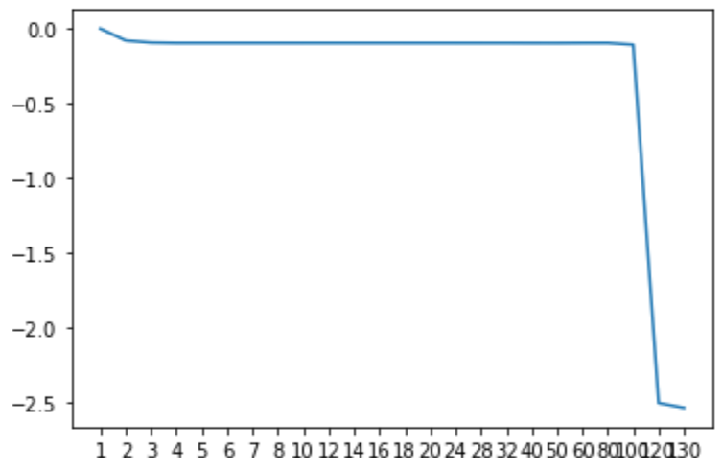
Ridge Regression
•SelectKBest features with grid Search hyperparameter settings
Notes:
BEFORE IMPUTATION OF MISSING VALUE

Slide 7
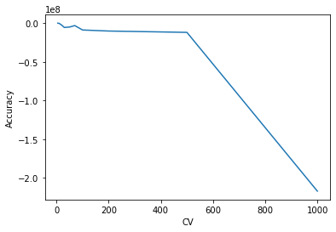
Lasso Regression
•Initial Cross Validation results with Normalization to regularize dataset
Notes:
BEFORE IMPUTATION OF MISSING VALUE

Slide 8
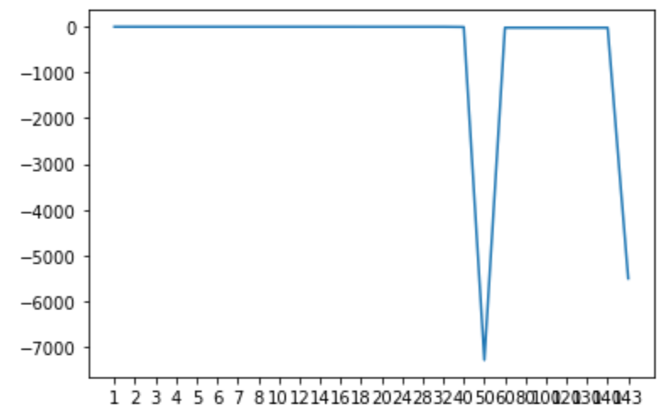
Lasso Regression
•using SelectKBest:
Notes:
BEFORE IMPUTATION OF MISSING VALUE

Slide 9
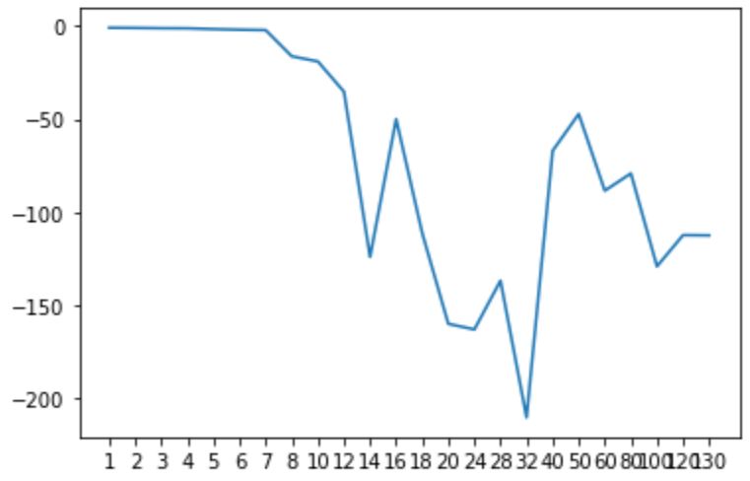
Random Forests
•After removing features with low correlation with target variable (|x|<0.001) and removing features with low variance, we get these scores for selectKBest features:
Notes:
BEFORE IMPUTATION OF MISSING VALUE

Slide 10
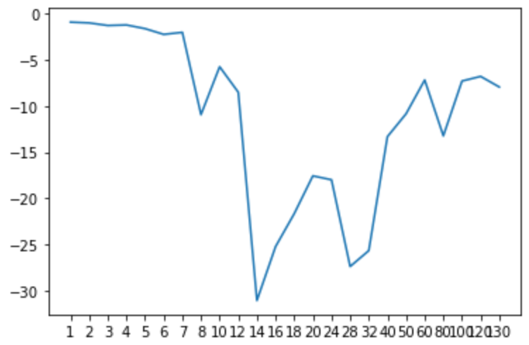
Random Forests
•After using Grid Search for Hyper Parameter tuning, we get these scores for selectKBest features
Notes:
BEFORE IMPUTATION OF MISSING VALUE

Slide 11
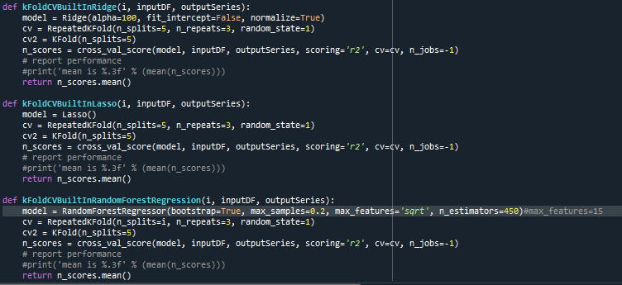

Slide 12
Regression Report
Notes:
We used a 50-Fold Cross Validation for Testing
50-60 features score the highest but the variance between scores is quite insignificant

Slide 13
Thank you!

